Slide 1
College Knowledge 101
Northern Guilford High School
September 29, 2022
6pm
Ms. Andrea Martin, Students A – D
Ms. Beth Knight, Students E – K
Ms. Leslie Deaton, Students L – Ri
Ms. Kristin Guthrie, Students Ro – Z

Slide 2
Agenda
Finding a College Home
Applying to College
Types of Admission Decisions
Different ways to apply to College
Transcripts
College Entrance Exams
Residency Determination
Letters of Recommendation
Paying for College $$$$$
Notes:
Bennett

Slide 4
Research, Meet, Visit
Use CFNC.org for college and career inventories and research. Collegedata.com, collegeboard.org, and collegescorecard.ed.gov allow students to search and compare 2000+ colleges and estimate their chances of admission.
Attend college lunch and Flex visits: Meet Admissions Representatives
October 3 – Wake Forest University (lunch)
October 4 – University of South Carolina (lunch)
October 18 – UNC, NC State, GTCC, University of Alabama, ASU/4-6:30pm NGHS Atrium and Auditorium
October 24—GAP (Flex)
Monitor Class of 2023 Senior Counseling Canvas page for important information
Listen to morning announcements
Attend college open houses/ schedule admission presentations and tours
Attend GCS College Fair Oct. 5/ 5-8pm on GTCC’s Cameron Campus
Notes:
Bennett

Slide 5
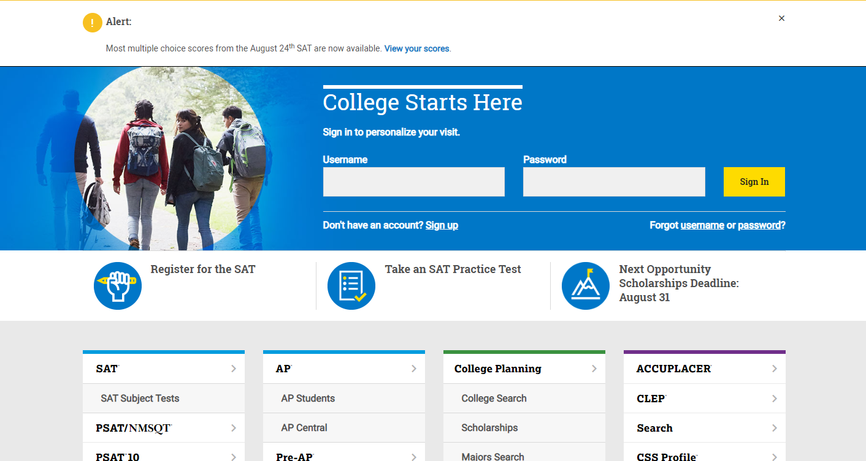
collegeboard.org

Slide 6
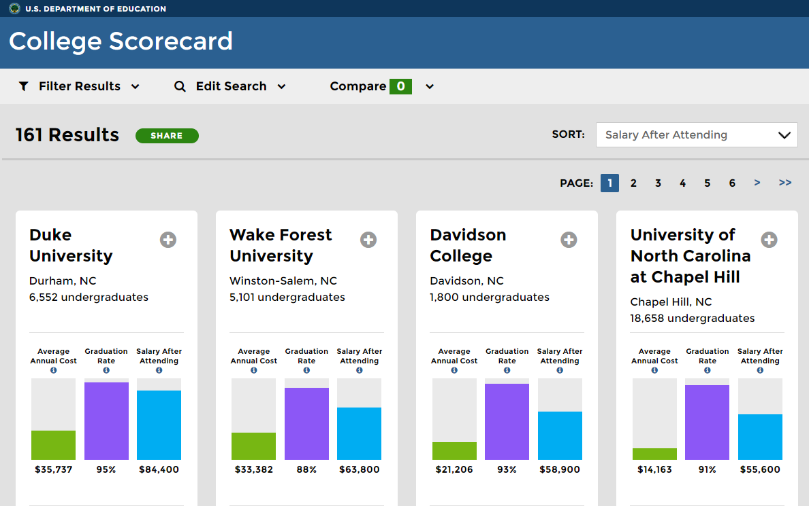
collegescorecard.ed.gov

Slide 8
Save the Date! College and Career Fair October 18th, Tuesday from 4-6:30 Featuring a College Panel at 6:00 with Special Guests from:

Slide 9
The State of North Carolina has:
•16 state-supported universities
•36 independent colleges and universities
•58 community colleges
A total of 110 in-state colleges and universities from which to choose.
So if you haven’t already visited, NOW is the time! Don’t wait any longer! Schedule a tour today!

Slide 10
2022 AVERAGE GPA, SAT, ACT
School | Avg. GPA | SAT CR | SAT Math | Avg. ACT Composite
UNC-G | 3.59 weighted | SAT Average 1181 |  | 24
UNC-W | 3.80-4.43
NC STATE | 4.31 weighted
UNC-CH | 74% in top 10% of high school class | SAT Average 1340-1500
East Carolina | 3.46—3.74 (unweighted)
UNC-Charlotte | 3.8-4.4 (weighted) 3.4-3.9 (unweighted) | SAT Average 1120-1340 |  | 21-28
NC A& T | 3.766 (weighted)
Duke | 7.8% Acceptance Rate | SAT 1500-1560 |  | 33-35
ASU | 3.82-4.34 (weighted) | SAT 1100-1270 |  | 22-28

Slide 13
Service Learning
www.x2vol.com
Graduating seniors with 75 hours of service learning will receive the Exemplary Award
Graduating seniors with 186 hours of service learning will receive the Service-Learning Diploma and cord
Seniors have until April 1 to log hours on x2vol.
Notes:
McCollester

Slide 14
Regular Decision
This is NOT BINDING, meaning if your student is accepted to the institution, they do not have to enroll
Later application deadline—generally early January
Decisions usually received late March/early April
Have until May 1st (National Decision Day) to accept or decline offer
Notes:
Rolling Admission – This college will process your application as soon as it is complete. They will send your admissions status results, usually within 2 – 4 weeks of the application completion. You have until May 1st to decide and deposit.

Slide 15
Early Action
This is NOT BINDING, meaning if your student is accepted to the institution, they do not have to enroll
May apply early action to multiple schools
Early application deadline—usually October/November
Typically receive admissions decision by late January
Students who are not admitted Early Action may be “deferred” to the Regular Decision deadline, though these policies will vary between schools.
Have until May 1 to accept or decline admissions offer

Slide 16
Early Decision
This is BINDING, meaning if your student is accepted to the institution they are expected to enroll; must sign a form indicating intent to enroll if admitted; usually requires a non-refundable deposit if admitted
Early application deadline
Typically receive admissions decision by December/January
This application is for students who absolutely know what their #1 choice school is and will attend if admitted no matter the aid received
Shows seriousness of applicant
Use school's net price calculator and consult with their financial aid officer before choosing Early Decision
You can only apply Early Decision to ONE school; must withdraw all other applications that have been submitted if accepted ED.

Slide 17
Different Ways to Apply
When you visit the school’s website and access the admissions section, you will:
Be directed to the school – specific application if that school is not part of the Common Application/Coalition
Be directed to a page that requires you to choose whether you will apply through the school specific application or if you wish to apply through the Common Application / Coalition

Slide 18
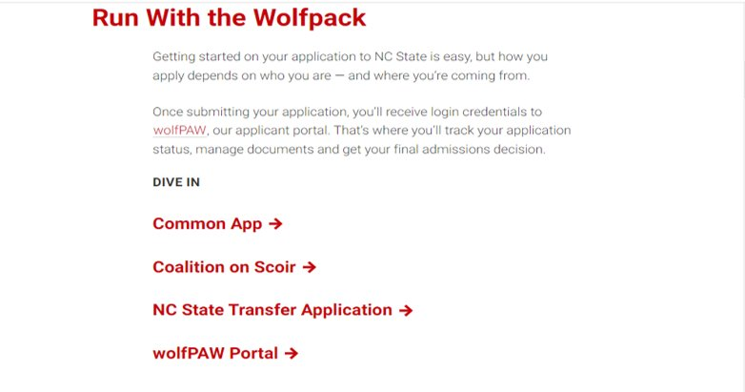

Slide 19
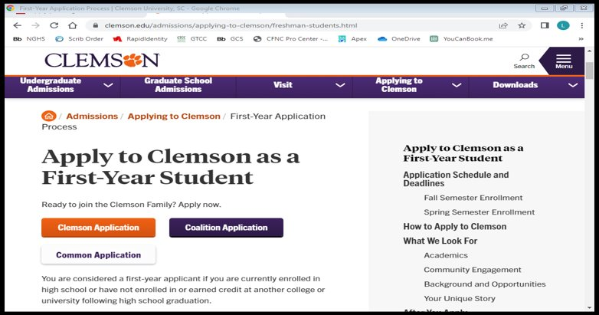

Slide 20
Common App FAQs
Class Rank Reporting: Exact
Rank Weighting: Weighted
GPA Scale Reporting: 5
GPA Weighting: Weighted
Class size: 327

Slide 21
Transcripts
For North Carolina colleges/universities students will request their transcripts through CFNC
For out of state colleges/universities students will request their transcripts through ScribOrder
For an unofficial copy students will request their transcript through ScribOrder and pick it up in the counseling office when it’s ready.
If you have taken a course(s) at GTCC through the Career & College Promise program, you will be required to send a GTCC transcript (in addition to your NGHS transcript) to the college you choose to attend.
Notes:
Bennett

Slide 22
College Entrance Exams
Send AP scores AFTER you’ve chosen your college to attend
Take or Retake the SAT/ACT
Super scoring is accepted at most universities
Fee waivers are available for qualified students – see counselor for details
When you initially register for a test, you may send the scores to up to 4 colleges as part of the registration fee.
After the test, sending scores from the websites has an additional fee.
Request official SAT/ACT test scores from www.collegeboard.org and www.act.org
UNC system schools are test optional throught the Fall 2024 application cycle!

Slide 23
2022-23 ACT Dates

Slide 24
2022-23 SAT Dates

Slide 25
A Completed Application
Includes:
Student’s Application and fee
ACT/SAT scores sent directly from the testing company to the college if choose to submit
Transcript
School report completed by the counselor
If required:
Student supplemental essay(s)
Letter(s) of recommendation

Slide 26
Letters of Recommendation
Research school requirements
Teachers, principals, and counselors can write on applicant’s behalf
Please ask your recommender 2 weeks in advance and include your resume; write a thank you
FERPA Waiver
Waiving your right lets colleges know that you will never try to read your recommendations. That in turn reassures colleges that your recommenders have provided support that is candid and truthful. If you choose not to waive your right, some recommenders may decline your request, and some colleges may disregard letters submitted on your behalf.
Notes:
Bennett

Slide 27
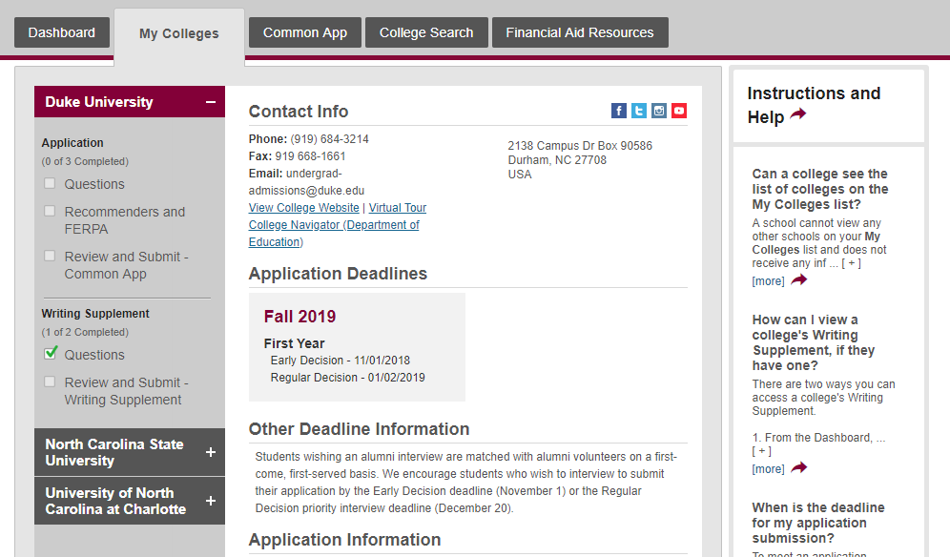

Slide 28
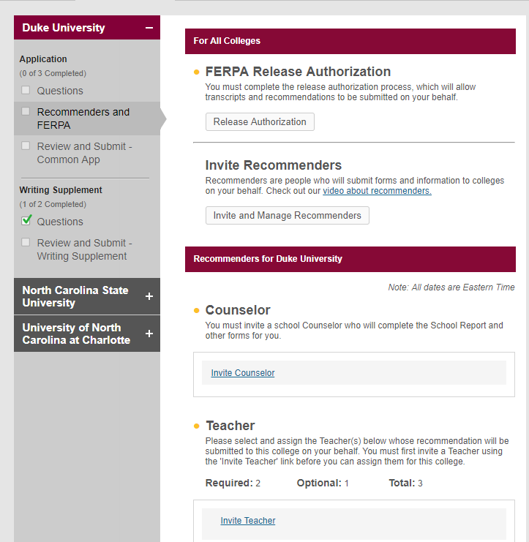
Must invite your counselor so we can upload the school profile!

Slide 29
NC Promise
The following universities have $500 tuition per semester:
UNC – Pembroke
Elizabeth City State
Western Carolina
Fayetteville State University

Slide 30
Community Colleges
There is no application fee for NC community colleges.
Can apply through CFNC or the school’s website.
You do not need to submit SAT/ACT scores if you plan to take the placement exam.
Can sign up for summer classes through college career promise and get tuition for free!

Slide 32
Residency Determination Services
For NC schools only
You will need to submit a residency application with the North Carolina Residency Determination Services (RDS), which is a government agency that serves the entire state.
Must know your CFNC login credentials!
It’s an online interview where you must provide documentation verifying your North Carolina residency.
Linked through the students' CFNC account.
At completion of interview, student will receive a Residency Certification Number (RCN)which will be requested on your college application.
Notes:
The website is linked on the application. ncresidency.com
Only complete once unless you transfer to another institution or take a summer school class at a different school. Or you don't enroll within 15 months of submitting the application.

Slide 33
Paying for College

Slide 34
Scholarships

Slide 35
Scholarship Search Engines

Slide 37
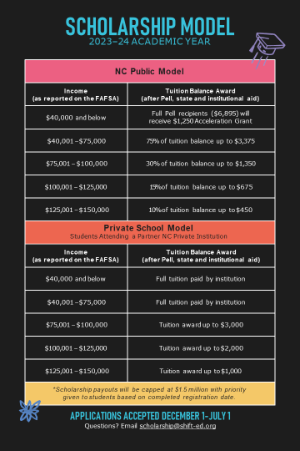

Slide 38
Introducing
Associate Director of Financial Aid
Anna Stovall

Slide 39
FAFSA 2023-2024 Free Application for Federal Student Aid
Opens on October 1 – must be completed each year student is in college
Use 2021 tax information
Priority aid deadline is often February 15
Must be filed by that date in order to be considered for institutional aid.
Colleges review Student Aid Report (SAR) and then compile a comprehensive package of aid for you.
College aid package indicates all grants, scholarships, subsidized loans, and work study for which you qualify
CSS Profile is REQUIRED for UNC, Elon, Davidson, Duke and Wake. $25 for first school, $16 each additional school.

Slide 40
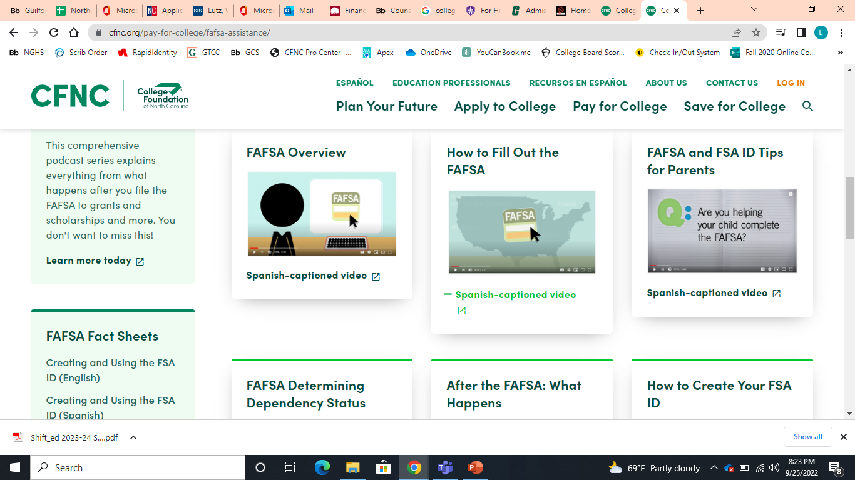
MANY HOW-TO FAFSA VIDEOS ON CFNC

Slide 41
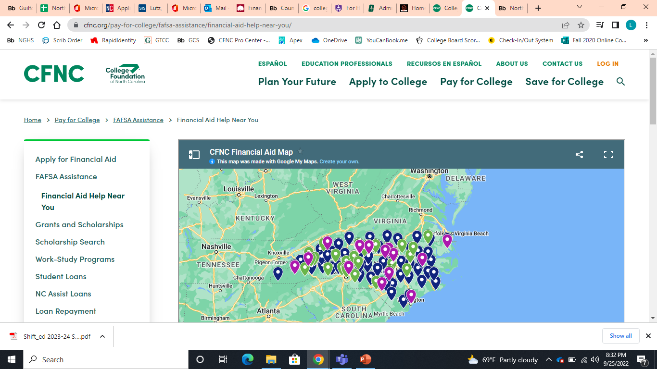
Every college financial aid office offers free FAFSA assistance.

Slide 42
Questions

Slide 43
Thank you for coming!
Notes:
Martin

